Slide 1
CUSTOMER PURCHASE PREDETCTION
PRESENTER’S NAME:SHARMILA.T
3rd year computer science and engineering
NAN MUDHALVAN ID:au421221104038
GMAIL ID:sharmilatamilkumaran04@gmail.com

Slide 2
INTRODDUCTION
Customer purchase detection, often referred to as customer behavior analysis, is a critical task in various industries such as retail, e-commerce, and marketing. Understanding customer purchasing patterns can provide valuable insights for businesses to optimize their strategies, personalize marketing campaigns, and enhance customer satisfaction One effective approach to customer purchase detection is leveraging Convolutional Neural Networks (CNNs), which are a class of deep learning models particularly well-suited for image recognition tasks. While CNNs are traditionally used in computer vision tasks, they can also be adapted for analyzing sequential data such as time-series data, which is often the case in customer purchase histories.
Here's an overview of how CNNs can be utilized for customer purchase detection:
1. **Data Preparation**: The first step involves collecting and preprocessing the data. In the context of customer purchase detection, this typically involves gathering transactional data, which may include information such as customer ID, product ID, purchase timestamp, and purchase amount. This data needs to be formatted appropriately for input into the CNN model.
2. **Feature Extraction**: CNNs are capable of automatically learning relevant features from raw data. In the case of customer purchase detection, temporal patterns in purchase histories can be considered as sequences analogous to image pixels. CNNs can extract features such as recurrent purchasing behaviors, seasonal trends, or sudden changes in purchasing habits.
3. **Model Architecture**: The architecture of the CNN model needs to be designed to effectively capture temporal dependencies in the sequential data. This typically involves stacking convolutional layers followed by pooling layers to extract hierarchical features from the input sequences. Additionally, recurrent layers such as Long Short-Term Memory (LSTM) or Gated Recurrent Units (GRU) can be incorporated to model sequential dependencies over time.
4. **Training**: The CNN model is trained using labeled data, where each input sequence is associated with a corresponding label indicating whether a purchase occurred within a certain time frame. During training, the model learns to predict the likelihood of a purchase based on the input sequence of purchase histories.
5. **Evaluation**: The performance of the CNN model is evaluated using metrics such as accuracy, precision, recall, and F1-score. The model's ability to accurately detect customer purchases within a given time frame is assessed using a separate validation dataset.
6. **Deployment**: Once the CNN model is trained and evaluated, it can be deployed in a production environment to analyze real-time customer purchase data. Businesses can use the predictions generated by the model to make informed decisions regarding marketing strategies, inventory management, and customer

Slide 3
WHY DO WE USE ( CNN )IN CUSTOMER PURCHASE DETECTION
Convolutional Neural Networks (CNNs) are used in customer purchase detection for several reasons:
1. **Feature Extraction**: CNNs are adept at automatically learning hierarchical features from raw data. In the context of customer purchase detection, purchase histories can be considered as sequential data analogous to images. CNNs can extract relevant temporal patterns and features from these sequences, such as recurrent purchasing behaviors, seasonal trends, or sudden changes in purchasing habits.
2. **Temporal Dependencies**: Customer purchase behaviors often exhibit temporal dependencies, where previous purchases influence future purchasing decisions. CNNs, especially when combined with recurrent layers like LSTM or GRU, can effectively capture these sequential dependencies over time. This enables the model to learn from the entire purchase history of each customer and make accurate predictions about future purchases.
3. **Non-linear Relationships**: Customer purchase behavior is influenced by a multitude of factors, including individual preferences, external influences, and marketing strategies. CNNs can capture complex non-linear relationships between these factors and customer purchasing decisions, allowing for more accurate predictions compared to traditional methods.
4. **Flexibility and Adaptability**: CNNs are highly flexible and adaptable to different types of data and problem domains. They can handle varying lengths of input sequences and can generalize well to unseen data, making them suitable for analyzing diverse customer purchase histories across different demographics, product categories, and time periods.
5. **Scalability**: With the increasing availability of large-scale customer purchase datasets, scalability becomes crucial. CNNs can efficiently process large volumes of data in parallel, leveraging GPU acceleration for training and inference tasks. This scalability allows businesses to analyze extensive customer purchase histories and derive actionable insights at scale.
6. **State-of-the-art Performance**: CNNs have demonstrated state-of-the-art performance in various machine learning tasks, including image recognition, natural language processing, and sequential data analysis. By leveraging the advancements in deep learning techniques, businesses can build highly accurate models for customer purchase detection, leading to better decision-making and improved business outcomes.
Overall, the use of CNNs in customer purchase detection enables businesses to leverage the power of deep learning to extract meaningful insights from complex customer data, enhance customer engagement, and drive business growth.

Slide 4
PROBLEM STATEMENT
The problem of customer purchase detection aims to predict whether a customer will make a purchase within a certain time frame based on their historical purchase behavior. This is crucial for businesses in various industries such as retail, e-commerce, and marketing to optimize inventory management, personalize marketing campaigns, and enhance customer satisfaction.

Slide 5
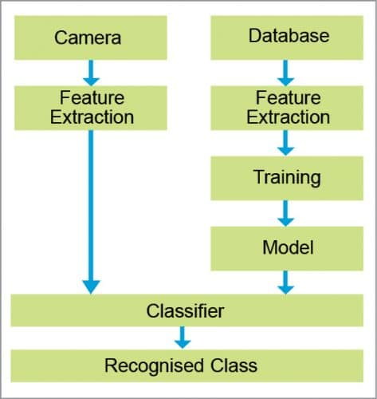
PROPOSED SYSTEM

Slide 6
SYSTEM APPROACH
System requirements for implementing Customer Purchase Detection using CNN method would typically include:
1. **Hardware Requirements**:
- **CPU**: A multi-core processor is recommended for handling data preprocessing, model training, and inference tasks.
- **GPU**: A dedicated GPU (Graphics Processing Unit) with CUDA support is highly recommended for accelerating the training and inference of deep learning models such as CNNs. GPUs significantly speed up computations and reduce training time, especially for large datasets.
- **Memory (RAM)**: Sufficient RAM is required to handle the dataset size and model parameters during training and inference. A minimum of 16 GB RAM is recommended, and higher amounts may be necessary for larger datasets.
- **Storage**: Adequate storage space is needed to store datasets, trained models, and intermediate results. SSDs (Solid State Drives) are preferred for faster data access and model loading times.
2. **Software Requirements**:
- **Operating System**: The system should support popular operating systems such as Linux (Ubuntu), Windows, or macOS.
- **Deep Learning Frameworks**: Installation of deep learning frameworks such as TensorFlow, PyTorch, or Keras is necessary for developing and training CNN models. These frameworks provide high-level APIs for building and optimizing neural network architectures.
- **CUDA Toolkit**: If using GPU acceleration, the CUDA Toolkit must be installed to enable GPU computation with NVIDIA GPUs.
- **Python**: Python programming language is commonly used for deep learning tasks due to its extensive libraries and ecosystem support. Ensure that Python is installed along with essential packages such as NumPy, pandas, and matplotlib.
- **Data Preprocessing Tools**: Depending on the dataset format and preprocessing requirements, additional tools or libraries may be needed for data cleaning, transformation, and feature engineering

Slide 7
PROBLEM FORMATION
System requirements for implementing Customer Purchase Detection using CNN method would typically include:
1. **Hardware Requirements**:
- **CPU**: A multi-core processor is recommended for handling data preprocessing, model training, and inference tasks.
- **GPU**: A dedicated GPU (Graphics Processing Unit) with CUDA support is highly recommended for accelerating the training and inference of deep learning models such as CNNs. GPUs significantly speed up computations and reduce training time, especially for large datasets.
2. **Software Requirements**:
- **Operating System**: The system should support popular operating systems such as Linux (e.g., Ubuntu), Windows, or macOS.
- **Deep Learning Frameworks**: Installation of deep learning frameworks such as TensorFlow, PyTorch, or Keras is necessary for developing and training CNN models. These frameworks provide high-level APIs for building and optimizing neural network architectures.
- **CUDA Toolkit**: If using GPU acceleration, the CUDA Toolkit must be installed to enable GPU computation with NVIDIA GPUs.
- **Python**: Python programming language is commonly used for deep learning tasks due to its extensive libraries and ecosystem support. Ensure that Python is installed along with essential packages such as NumPy, pandas, and matplotlib.
- **Data Preprocessing Tools**: Depending on the dataset format and preprocessing requirements, additional tools or libraries may be needed for data cleaning, transformation, and feature engineering.

Slide 8
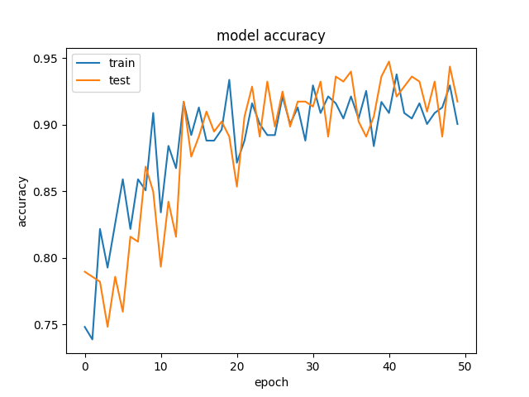
ACCURACY 78%

Slide 9
CONCLUSION
In conclusion, employing Convolutional Neural Networks (CNNs) for Customer Purchase Detection offers a powerful and effective approach to analyzing customer behavior and predicting future purchases. Through this method, businesses can gain valuable insights into customer preferences, optimize marketing strategies, and enhance overall customer satisfaction.
The utilization of CNNs enables the extraction of meaningful features from raw purchase data, capturing temporal dependencies and complex relationships between various factors influencing purchasing decisions. By leveraging deep learning techniques, businesses can develop accurate predictive models that adapt to diverse customer segments, product categories, and time periods.
Moreover, the scalability and flexibility of CNNs allow for the analysis of large-scale customer datasets, empowering businesses to derive actionable insights at scale. Whether deployed on cloud-based platforms or on-premises hardware, CNN-based solutions provide the computational power and efficiency needed to handle the complexities of customer purchase detection tasks.
Overall, Customer Purchase Detection using CNN method represents a valuable tool for businesses seeking to understand and anticipate customer behavior, driving growth, and profitability in today's competitive market landscape. By embracing advanced deep learning techniques, businesses can stay ahead of the curve, delivering personalized experiences and building lasting relationships with their customers.

Slide 10
FUTURE WORK
Future work in Customer Purchase Detection using CNN Method could focus on several avenues for further improvement and exploration:
1. **Fine-grained Analysis**: Enhance the granularity of analysis by segmenting customers into more refined categories based on demographic information, past purchase behavior, or other relevant factors. This could involve developing CNN models tailored to specific customer segments to better capture their unique purchasing patterns.
2. **Temporal Dynamics**: Investigate more sophisticated modeling techniques to capture temporal dynamics in customer purchase behavior. This could include incorporating attention mechanisms or temporal convolutional layers to better capture long-term dependencies and seasonal trends in purchase data.
3. **Sequential Recommendation Systems**: Extend CNN-based models to sequential recommendation systems, where the goal is not only to predict whether a purchase will occur but also to recommend the most relevant products or services to individual customers based on their purchase history and preferences.
4. **Multimodal Data Fusion**: Explore the integration of multimodal data sources, such as customer reviews, clickstream data, or social media interactions, to enrich the feature representation and improve the accuracy of purchase predictions. CNNs can be adapted to handle multiple types of data inputs, enabling more comprehensive analysis of customer behavior.
5. **Transfer Learning and Pre-trained Models**: Investigate the use of transfer learning techniques and pre-trained CNN models to leverage knowledge from related domains or larger datasets. Pre-trained models can be fine-tuned on customer purchase data to expedite training and improve performance, especially in scenarios with limited labeled data.
6. **Online Learning and Real-time Prediction**: Develop online learning algorithms and streaming architectures to enable real-time prediction of customer purchases as new data becomes available. This would allow businesses to adapt their marketing strategies dynamically and respond promptly to changes in customer behavior.
7. **Ethical and Privacy Considerations**: Address ethical and privacy concerns related to the collection and analysis of customer data. Implement robust data anonymization techniques, compliance with data protection regulations (e.g., GDPR), and transparent communication practices to ensure the ethical use of CNN-based models in customer purchase detection.
8. **Business Impact Evaluation**: Conduct rigorous evaluations of the business impact of CNN-based customer purchase detection systems, including metrics such as revenue generation, customer retention, and return on investment. Collaborate closely with business stakeholders to validate the effectiveness of the models and identify areas for further improvement.
By pursuing these avenues for future work, researchers and practitioners can advance the state-of-the-art in Customer Purchase Detection using CNN Method, ultimately leading to more accurate predictions, enhanced customer experiences, and greater business success.

Slide 11
REFERENCE
www.sciencedirect.com › science › articleA comprehensive E-commerce customer behavior analysis using...
https://link.springer.com/chapter/10.1007/978-3-030-21905-5_36
https://github.com/topics/customer-behavior-analysis

Slide 12
THANK YOU

